Slide 1
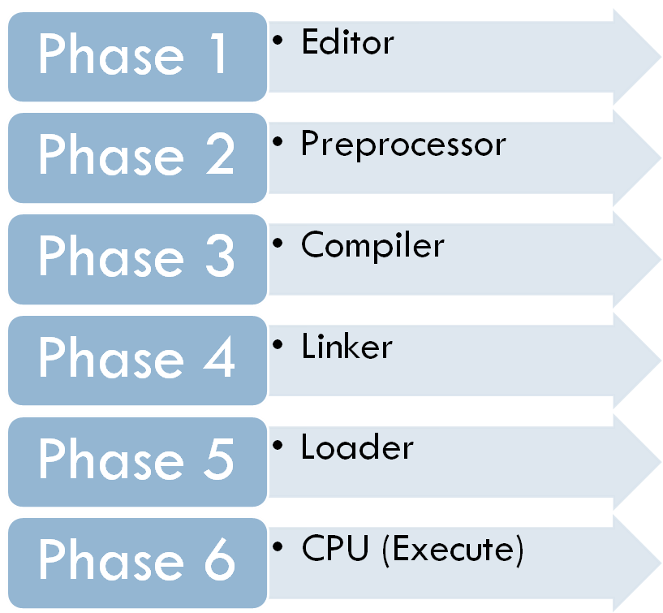
C Development Environment
Disk
Program is created using the Editor and stored on Disk.
Disk
Pre-processor program processes the code.
Disk
Compiler creates object code and stores it on Disk.
Disk
Linker links object code with libraries, creates a.out and
stores it on Disk
Disk
Loader puts Program in
Memory
Disk
CPU takes each instruction and executes it, storing new data values as the program executes.

Slide 2
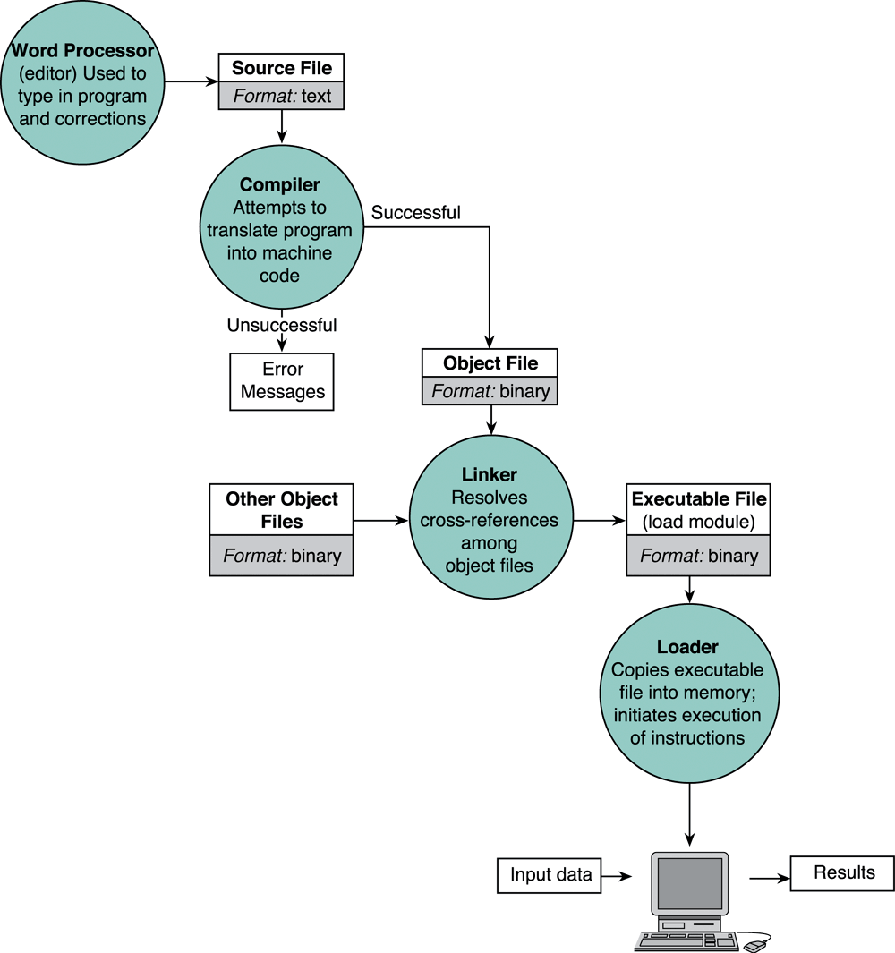
C Development Environment
Entering, translating, and running a High-Level Language Program

Slide 3
Constant example – volume of a cone
#include <stdio.h>
int main(void)
{
const double pi = 3.412;
double height, radius, base, volume;
printf(“Enter the height and radius of the cone:”);
scanf(“%lf %lf”,&height, &radius);
base = pi * radius * radius;
volume = (1.0/3.0) * base * height;
printf(“\nThe volume of a cone is %f ”, volume);
return 0;
}

Slide 4
#define
You may also associate constant using #define preprocessor directive
#include <stdio.h>
#define pi 3.412
int main(void)
{
double height, radius, base, volume;
printf(“Enter the height and radius of the cone:”);
scanf(“%lf %lf”,&height,&radius);
base = pi * radius * radius;
volume = (1.0/3.0) * base * height;
printf(“\nThe volume of a cone is %f ”, volume);
return 0;
}

Slide 5
Escape Sequence
Escape Sequence | Effect
\a | Beep sound
\b | Backspace
\f | Formfeed (for printing)
\n | New line
\r | Carriage return
\t | Tab
\v | Vertical tab
\\ | Backslash
\” | “ sign
\o | Octal decimal
\x | Hexadecimal
\O | NULL

Slide 6
Placeholder / Conversion Specifier
No | Conversion Specifier | Output Type | Output Example
1 | %d | Signed decimal integer | 76
2 | %i | Signed decimal integer | 76
3 | %o | Unsigned octal integer | 134
4 | %u | Unsigned decimal integer | 76
5 | %x | Unsigned hexadecimal (small letter) | 9c
6 | %X | Unsigned hexadecimal (capital letter) | 9C
7 | %f | Integer including decimal point | 76.0000
8 | %e | Signed floating point (using e notation) | 7.6000e+01
9 | %E | Signed floating point (using E notation) | 7.6000E+01
10 | %g | The shorter between %f and %e | 76
11 | %G | The shorter between %f and %E | 76
12 | %c | Character | ‘7’
13 | %s | String | ‘76'

Slide 7
Few notes on C program…
C is case-sensitive
  Word, word, WorD, WORD, WOrD, worD, etc are all different variables / expressions
    Eg. sum = 23 + 7
    What is the value of Sum after this addition ?
Comments (remember 'Documentation'; Chapter 2)
  are inserted into the code using /* to start and */ to end a comment
  Some compiler support comments starting with ‘//’
  Provides supplementary information but is ignored by the preprocessor and compiler
    /* This is a comment */
    // This program was written by Hanly Koffman

Slide 8
Few notes on C program cont…
Reserved Words
  Keywords that identify language entities such as statements, data types, language attributes, etc.
  Have special meaning to the compiler, cannot be used as identifiers (variable, function name) in our program.
  Should be typed in lowercase.
  Example: const, double, int, main, void,printf, while, for, else (etc..)

Slide 9
Few notes on C program cont…
Punctuators (separators)
  Symbols used to separate different parts of the C program.
  These punctuators include:
    [ ] ( ) { } , ; “: * #
  Usage example:
    int main void()
    {
    int num = 10;
    printf(“%d”, num);
    return 0;
    }

Slide 10
Common Programming Errors
Debugging → Process removing errors from a program
Three (3) kinds of errors :
  Syntax Error
    a violation of the C grammar rules, detected during program translation (compilation).
    statement cannot be translated and program cannot be executed

Slide 11
Common Programming Errors
  Run-time errors
    An attempt to perform an invalid operation, detected during program execution.
    Occurs when the program directs the computer to perform an illegal operation, such as dividing a number by zero.
    The computer will stop executing the program, and displays a diagnostic message indicates the line where the error was detected

Slide 12
Common Programming Errors
  Logic Error/Design Error
    An error caused by following an incorrect algorithm
    Very difficult to detect - it does not cause run-time error and does not display message errors.
    The only sign of logic error – incorrect program output
    Can be detected by testing the program thoroughly, comparing its output to calculated results
    To prevent – carefully desk checking the algorithm and written program before you actually type it

